Slide 1
Supporting Recovery through Housing
Valerie Mielke, MSW
Assistant Commissioner
Division of Mental Health and Addiction Services
March 28, 2017

Slide 2
Supportive Housing
Providers are responsible for ensuring access to a flexible and responsive system of support services that can assist individuals to maintain independence and a lifestyle of their choosing. In effect, the “consumer” becomes a “tenant” (who can only be evicted under NJ Tenant-Landlord law).
Consumer residents assume responsibility for their home, including payment of rent and managing routine household maintenance. The consumer resident has a lease and the key to the home and has control over access to it.
Supportive housing offers individuals opportunities for community integration and involvement in community life and citizenship. Emphasis is placed on the development and strengthening of natural supports and access to community services and programs. The resident determines what mental health services they need and wish to use.

Slide 3
Separation of Housing and Services
Why Separate Housing from Services
  Historically provider contracts contained service dollars and housing dollars
  In many instances the staff person who was providing the clinical support was also responsible for collecting the consumer’s rent
Potential for misperception that if the consumer does not comply with staff direction his/her housing would be jeopardized

Slide 4
HUD 811
In April 2015, the US Dept. Of Housing and Urban Development (HUD) awarded the NJ HMFA (HMFA) 206 Section 811 Project Based Rental Assistance (PRA) subsidies to provide rental assistance for extremely low income persons with disabilities and extremely low income households with at least one person with a disability.
63 DHS recycled subsidies and 40 DCA subsidies also were leveraged as part of this grant. All 103 subsidies have been awarded to date.
HMFA is in partnership with the NJ DHS to select individuals leaving developmental centers, state psychiatric hospitals, and individuals who are homeless or at risk of institutionalization.
As new construction for the 206 HUD 811 subsidized units are completed, DMHAS has been working with the PATH providers to get referrals for the subsidized units. To date, 9 units have been completed, and 9 referrals have been made.

Slide 5
The Supportive Housing Connection
The Supportive Housing Connection (SHC) is a collaborative partnership among the NJ Department of Human Services (DHS) and the NJ Housing and Mortgage Finance Agency (NJHMFA) to administer NJDHS rental subsidies and connect people (though the NJ Housing Resource Center – www.njhrc.gov) served by DHS to a wide pool of quality housing opportunities across the state.
The SHC also conducts inspections of participating housing units to ensure their physical integrity and compliance with HUD Quality Standards.
Currently the SHC is managing DHS rental subsidies for 3,595 tenants.

Slide 6
Supportive Housing in response to Superstorm Sandy
Beginning June, 2014 - 289 consumers, 152 mental health and 137 substance use disorder consumers received subsidy and services.
As of March, 2017 - 145 consumers continued to receive subsidy and services and 144 consumers have graduated, received mainstream rental subsidies or left the program.

Slide 7
Medication Assisted Treatment Initiative (MATI)
Currently, there are a total of 67 consumers served by this DMHAS program.
  65 consumers are housed, 1 consumer is pending placement and 1 other is pending approval.
30 consumers have been housed for 7-9 years
17 consumers have been housed for 4- 6 years
18 consumers have been housed for 1-3 years

Slide 8
Women’s Intensive Supported Housing (WISH)
Combines supportive housing with intensive case management and wraparound services to pregnant and/or parenting women with substance use disorders who are homeless or at risk of homelessness and being discharged from or have successfully completed residential treatment in a DHS licensed substance use treatment facility within the past 30 days
Supported by a Women’s Set Aside Federal Block Grant annualized funding of $187,000
Awarded through an RFP process to Center for Great Expectations, Fall 2015
Includes ten (10) DMHAS sponsored rental subsidies

Slide 9
Mental Health Supportive Housing Initiatives
Specialty types of Supportive Housing evolved over the last 10 years based on feedback from constituents, state hospital treatment teams and DMHAS central office staff
  Residential Intensive Support Teams (RIST)
  Medically-Enhances Supportive Housing
  Enhanced Supportive Housing
  Forensically-Involved Supportive Housing
  Co-occurring DD/MI Supportive Housing
  At-Risk Supportive Housing

Slide 10
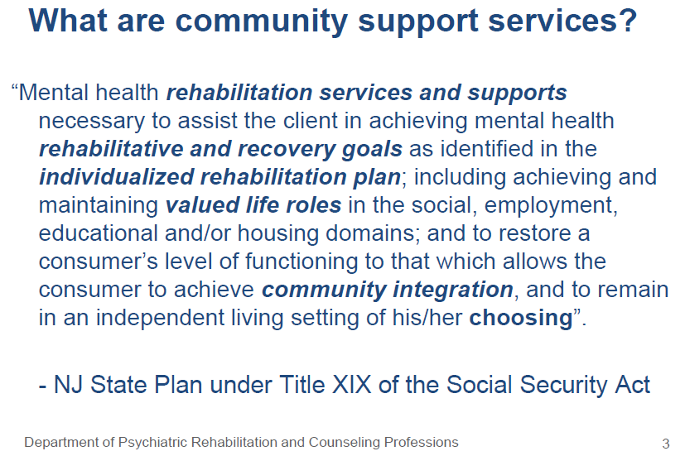
Community Support Services (CSS)

Slide 11
CSS has changed the nature of services
Prior to CSS
CSS
Services provided to individual are determined by agency staff
Services are only available at certain locations (e.g., partial care)
Services provided will be based on individual choice
Services are available where needed (e.g. individual learns budgeting and/or nutrition skills at the market)

Slide 12
Olmstead Settlement Outcomes
What is Olmstead?
Key elements in NJ’s Olmstead Settlement Agreement

Slide 13
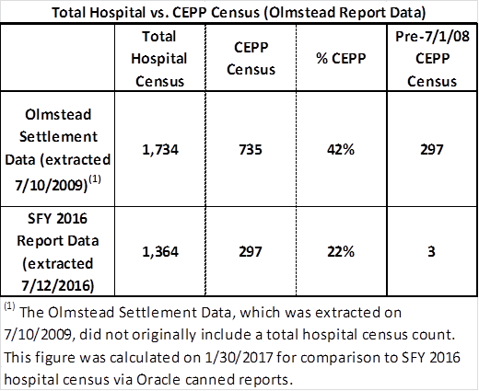
Figure 11: Pre and Post-Olmstead Summary
Total Hospital and CEPP Census

Slide 14
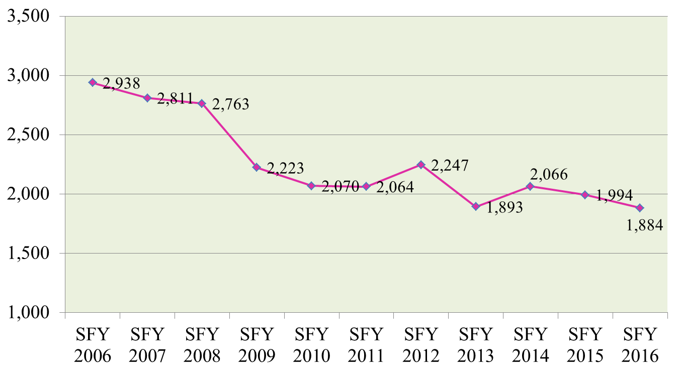
Figure 1: Admissions to NJ Regional State Psychiatric Hospitals:
SFY 2006-2016
(Excluding Ann Klein Forensic Center)

Slide 15
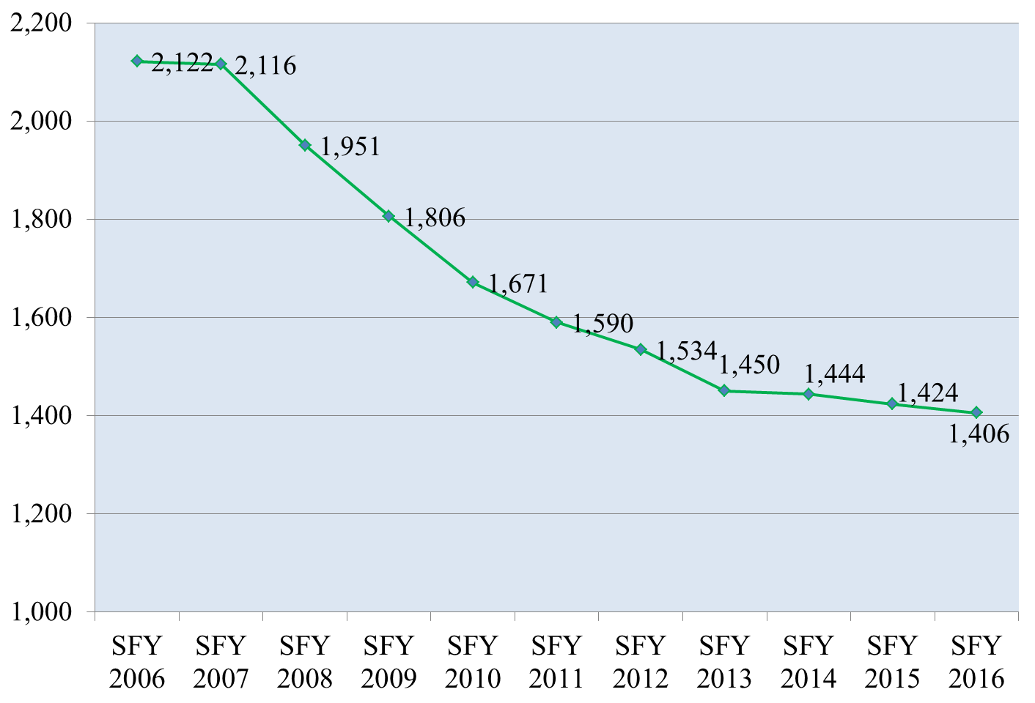
Figure 3: Total Average Census at NJ Regional State Psychiatric Hospitals
(excl. AKFC): SFY 2006 - 2016

Slide 16
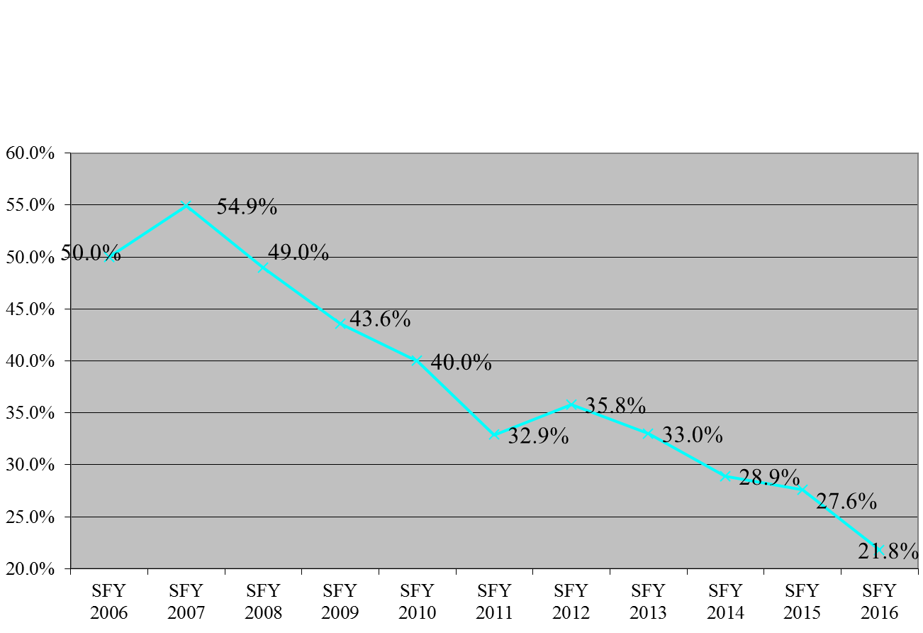
Figure 4: Proportion of Year End NJ Regional State Psychiatric Hospital Census on CEPP Status:
SFY 2006 - 2016
(Excluding Ann Klein Forensic Center)

Slide 17
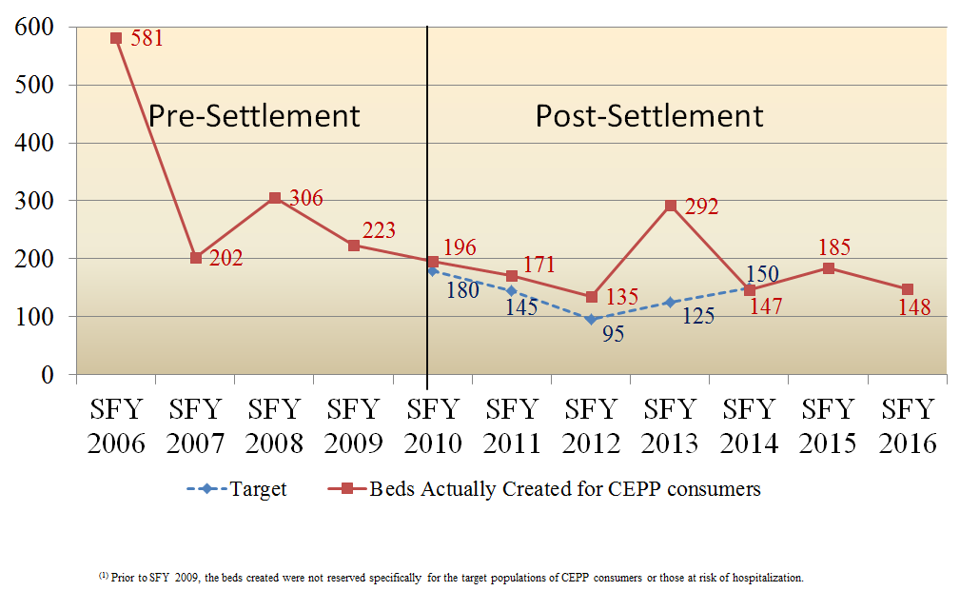
Figure 5: Supportive Housing (SH) Beds for CEPP Clients in the Regional State Psychiatric Hospitals:
Targets vs. Beds Actually Created, SFY 2006 – 2016⁽¹⁾

Slide 18
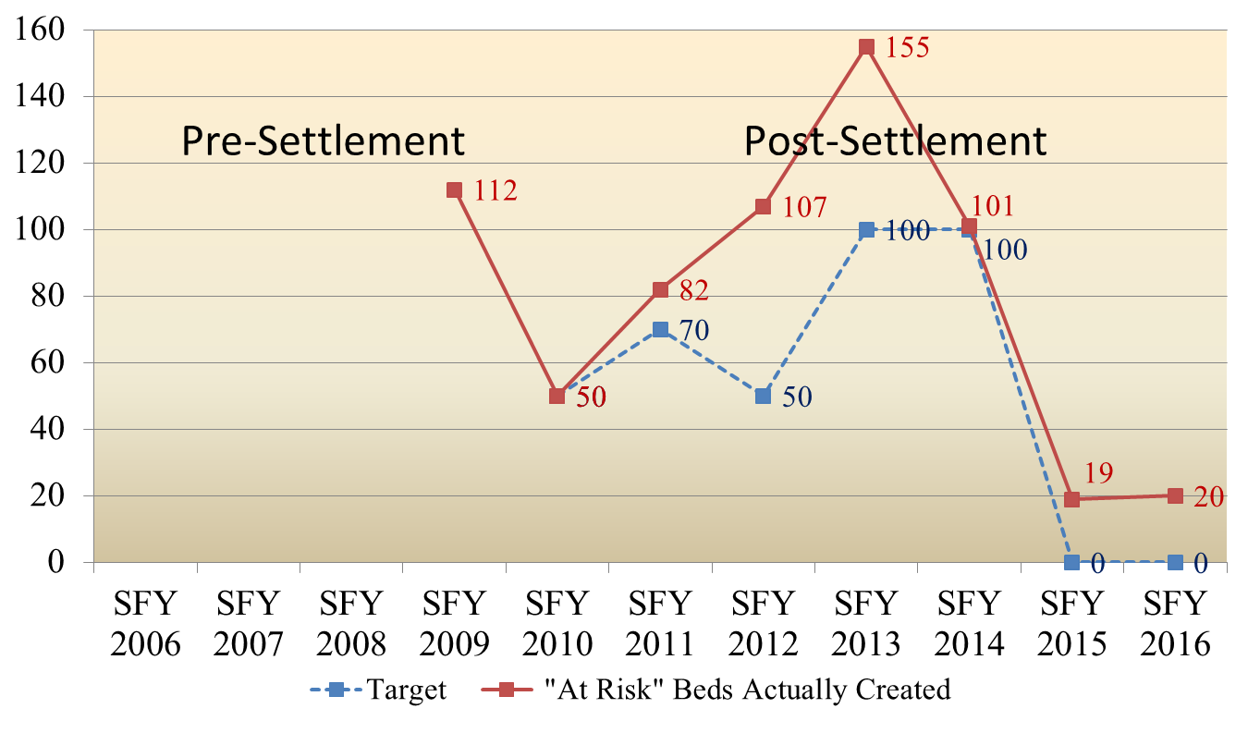
Figure 6: Supportive Housing (SH) Beds for At-Risk Populations:
Targets vs. Beds Actually Created, SFY 2006 – 2016

Slide 19
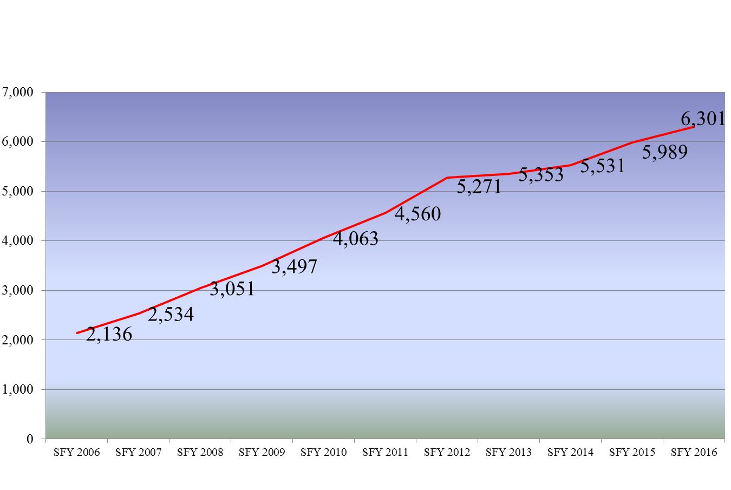
Figure 7: Clients Served by the SMHA in Supportive Housing (duplicated) SFY 2006 – SFY 2016
Pre-Settlement
Post-Settlement

Slide 20
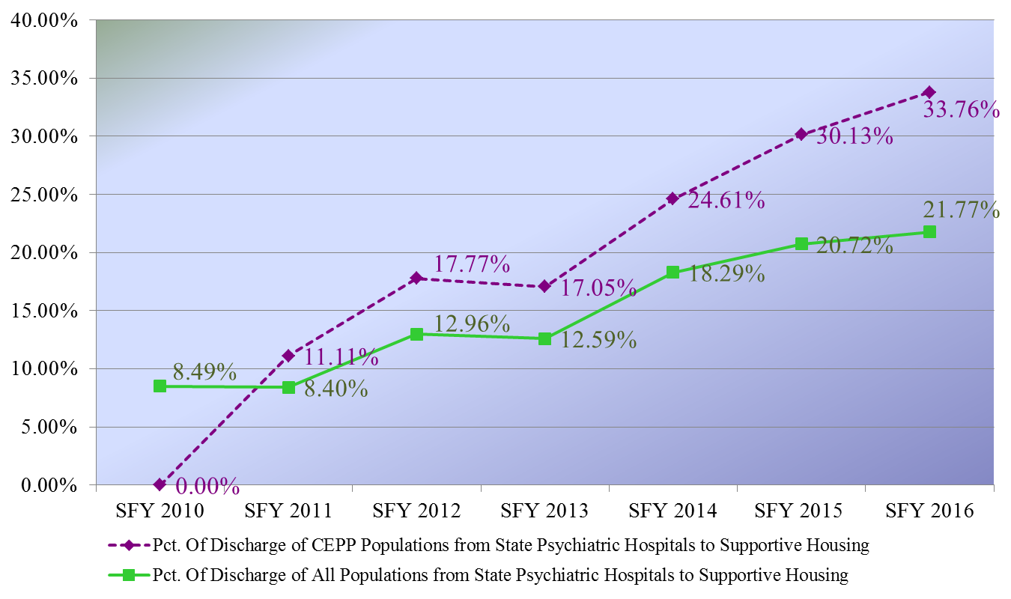
Figure 8: Percent of Discharges from NJ Regional State Psychiatric Hospitals (excl. AKFC) to Supportive Housing (SH):
CEPP Population and All Populations,
SFY 2010 – 2016

Slide 21
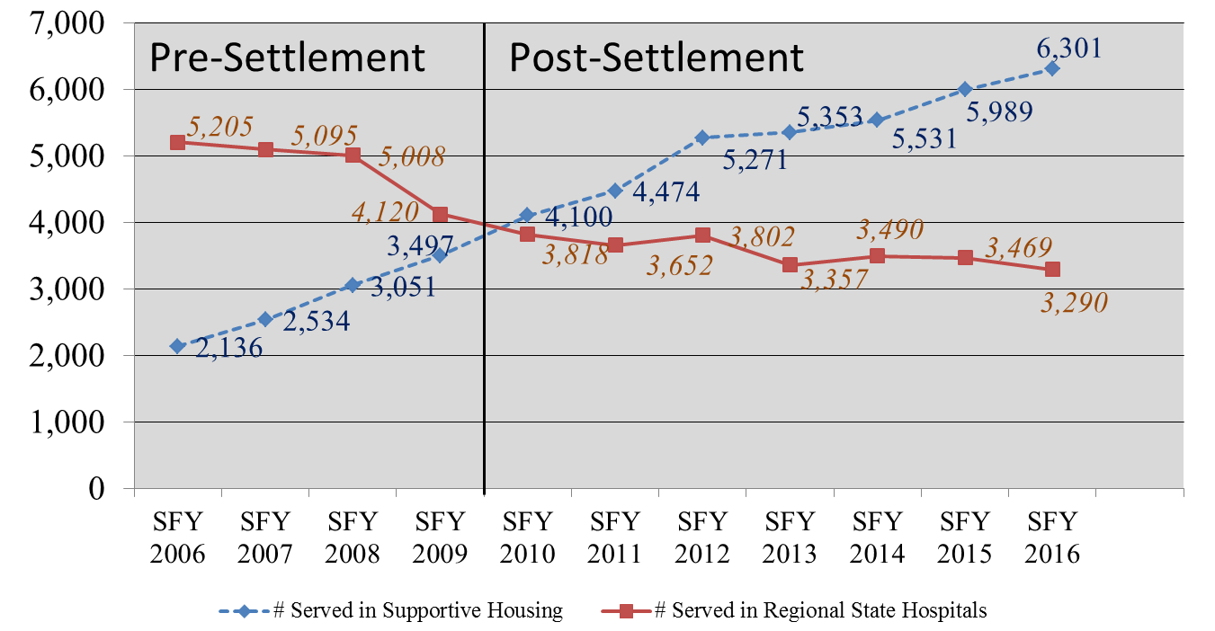
Figure 9: Clients Served by the SMHA in Supportive Housing (duplicated) and in the Regional State Hospitals SFY 2006 – SFY 2016

Slide 22
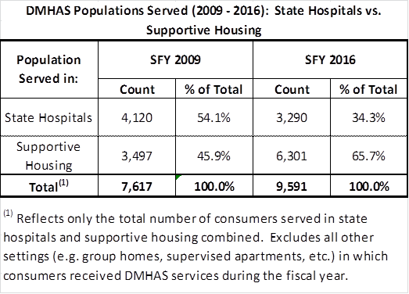
Figure 15: Pre and Post-Olmstead Summary
Hospitalization vs. Supportive Housing

Slide 23
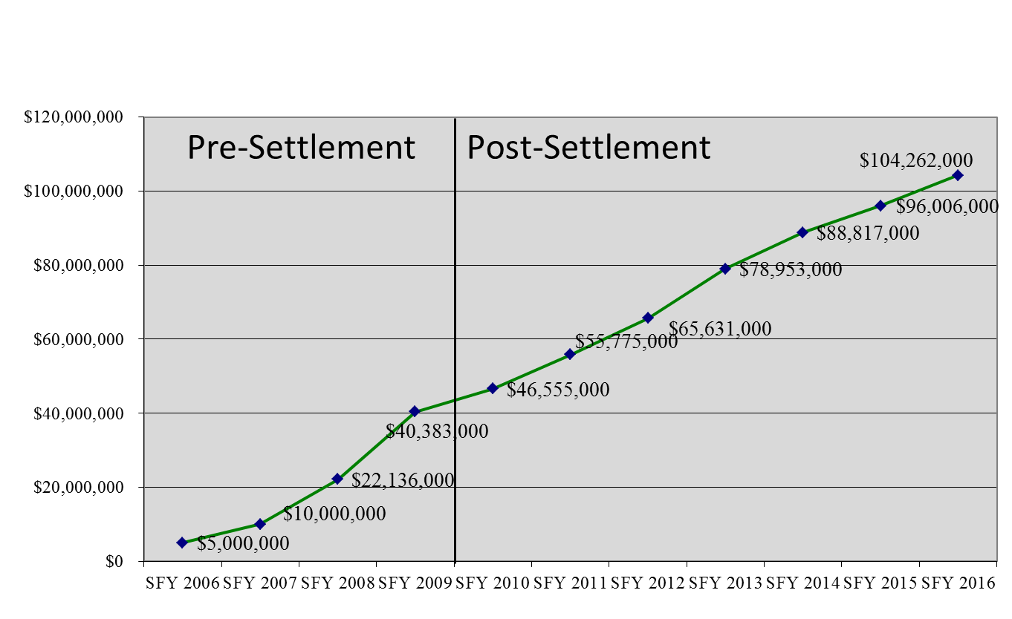
Figure 10: NJ Division of Mental Health and Addictions Services
Cumulative Olmstead Appropriations:
SFY 2006 - 2016

